Slide 1
I/O and Vreg Board for EN Mic/Sensor Probe

Slide 2
Probe I/O & vreg layout – dual four-wire
ver 1.03
Molex 0527450697
0.5mm ZIF
width 0.59” (15mm)
J5
0812”
(20.6mm)
8
6
5
4
3
1
+2.8
+A
-A
gnd
MEMS
+3.3
VCC
GND
+5
0.787”
(20mm)
width 0.375” (10mm)
AUDIO OUT
SENSOR
I2C IN
J4
J3
J2
gnd
+A
gnd
-A
gnd
+Vcc
SDA
gnd
+5v
SDA
SCL
SCL
1.375”
(35mm)
Earth Biometrics LLC – Copyright 2023

Slide 3
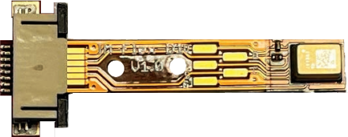
Probe I/O & vreg layout – dual four-wire
width 0.59” (15mm)
J5
0.812”
2.5”
8
6
5
4
3
1
(20.6mm)
+2.8
+A
-A
gnd
MEMS
+3.3
VCC
GND
+5
0.787”
width 0.375” (10mm)
AUDIO OUT
SENSOR
I2C IN
(20mm)
J4
J3
J2
gnd
+A
gnd
-A
gnd
+Vcc
SDA
gnd
+5v
SDA
SCL
SCL
1.375”
(35mm)
Earth Biometrics LLC – Copyright 2023

Slide 4
Probe I/O & vreg layout – dual four-wire
ver 2.00
1.0”
(25.4mm)
Molex 0527450697
0.5mm ZIF
4mm
J5
+3.3
GND
V_{CC}
+5
1.0”
(25.4mm)
AUDIO OUT
J3
I2C IN
J4
J2
gnd
+A
gnd
-A
SDA
SCL
Gnd
V_{CC}
gnd
+5v
SDA
SCL
2.54mm pin spacing,
J2, J3, J4
1.375”
(35mm)
Earth Biometrics LLC – Copyright 2023

Slide 5
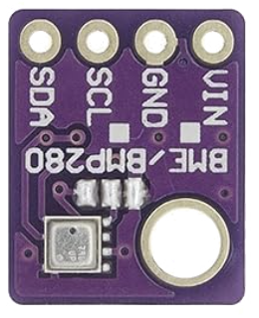
Probe I/O & vreg layout – dual four-wire
ver 2.00
0875”
(22 mm)
Molex 0527450697
0.5mm ZIF
J5
+3.3
GND
Add 10k ohm termination to SDA/SCL
V_{CC}
+5
1.0”
(25.4mm)
Add R/C coupling to output
AUDIO OUT
J3
I2C IN
J4
V_{CC}
J2
gnd
+A
gnd
-A
gnd
+5v
SDA
SCL
Earth Biometrics LLC – Copyright 2023

Slide 6
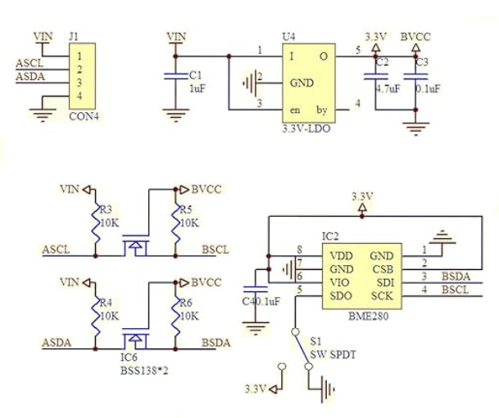
BMP280 Sensor
BMP280?

Slide 7
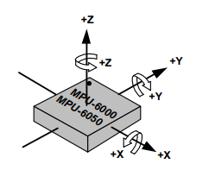
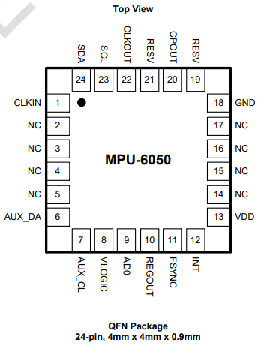
Dual-Mode, Single-Chip Orientation Sensor
a - accelerometer
g - gyro
a - accelerometer
g - gyro
g - gyro
a - accelerometer
301
302
Fig. 3a
Fig. 3b

Slide 8
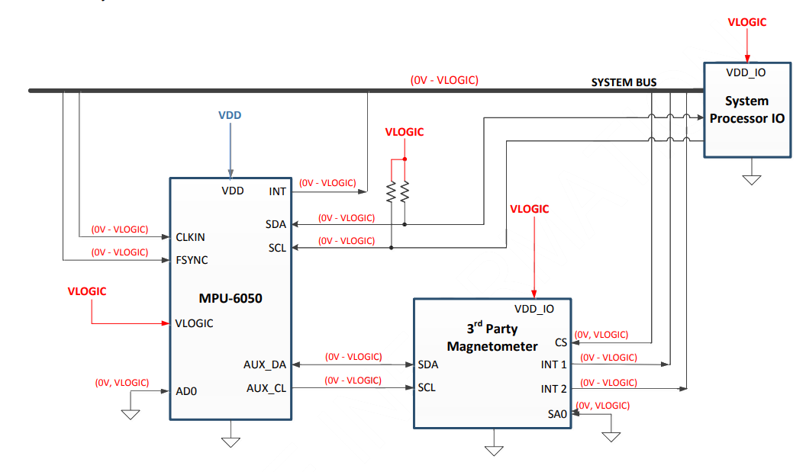
Orientation Sensor Schematic
402a
403
402b
401
404
Fig. 4

Slide 9
Archives
Earth Biometrics LLC – Copyright 2023

Slide 10
I/O & Vreg Layout
Molex 0527450697
0.5mm ZIF
width 0.59” (15mm)
0812”
(20.6mm)
8
6
5
4
3
1
+2.8
+A
-A
gnd
2.54mm
width 0.375” (10mm)
J5
2.54mm
+5
J1
5
4
3
2
1
+Vcc
+3.3
1.375”
(35mm)
0.787”
(20mm)
gnd
+Vcc
SDA
-A
+A
SCL
+5v
SCL
gnd
SDA
width 0.315” (8mm)
2.00mm
2.00mm
2.00mm
J4
3 pin
J3
4 pin
J2
3 pin
1
2
3
1
2
3
4
1
2
3
Earth Biometrics LLC – Copyright 2023

